Slide 1

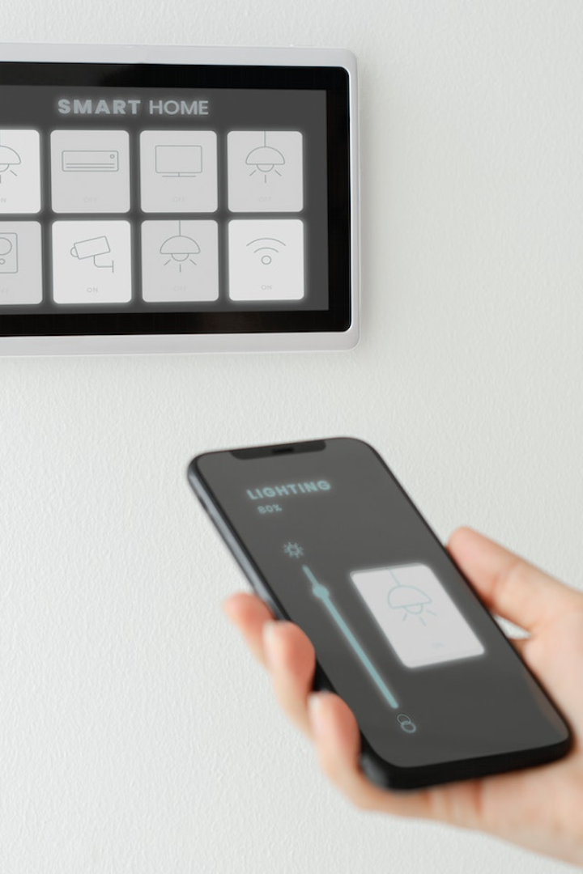

Voice Control Home Automation Light Using Google Assistance V2
An innovative solution that allows users to control their home lighting with voice commands. Introducing the powerful features of Google Assistance V2.

Slide 2

What is Voice Control Home Automation?
Voice control home automation refers to the ability to control various aspects of a smart home using voice commands. In this presentation, we focus on the integration of voice commands specifically for controlling lights.

Slide 3

Why is it Important?
Voice control home automation offers a convenient and hands-free way to interact with smart devices, improving the overall user experience. It saves time and adds efficiency to everyday tasks.

Slide 4

Introduce Google Assistance V2
Google Assistance V2 is a cutting-edge voice control technology developed by Google. It provides advanced features and enhanced compatibility with a wide range of smart devices.

Slide 5

Features of Google Assistance V2
1
Voice Commands for Controlling Lights
2
Integration with Smart Devices
3
Personalized User Experience
Seamlessly control not only lights but other smart devices such as thermostats, locks, and security systems.
Google Assistance V2 learns user preferences and adapts to provide personalized recommendations and suggestions for a tailor-made experience.
Easily adjust the brightness, color, and ambience of your lights with simple voice commands.

Slide 6

Benefits of Voice Control Home Automation
1
Convenience and Ease of Use
2
Energy Efficiency
3
Enhanced Security and Safety
Control your home lighting and other devices with a simple voice command, eliminating the need for manual interaction.
Optimize energy consumption by adjusting lighting levels based on specific needs and usage patterns.
Ensure the safety of your home by controlling lights remotely, creating the illusion of an occupied home even when you're away.

Slide 7

Challenges and Limitations
1
Technical Issues and Compatibility
2
Privacy Concerns
3
Learning Curve for Users
Voice control systems raise valid privacy concerns, and users must weigh the convenience against potential risks.
Some users may find it challenging to adapt to voice control technology initially, but with time and practice, it becomes more intuitive.
Some smart devices may not be compatible with voice control, requiring additional setup or incompatibility issues to be resolved.

Slide 8
Future of Voice Control Home Automation
1
Advancements in Technology and AI
2
Integration with Other Smart Home Devices
3
Potential for Voice-Controlled Smart Cities
Continued advancements in technology and artificial intelligence will enhance the accuracy and capabilities of voice control systems.
Voice control will expand its reach beyond lighting and integrate seamlessly with other smart home devices for a comprehensive automation experience.
With further development, voice control home automation has immense potential to be the foundation of voice-controlled smart cities for a more connected and efficient urban lifestyle.

Slide 9

Conclusion
Recap of Key Points
Explored the concept of voice control home automation, focusing on lighting control and the features of Google Assistance V2.
Importance of Voice Control Home Automation
Highlighted the convenience, energy efficiency, and improved security provided by this technology.
Encouragement to Explore and Embrace this Technology
Concluding with an invitation to embrace the possibilities and benefits of voice control home automation in our everyday lives.

